Slide 1
The New Edmonds Waterfront Center Edmonds Senior Center
Feasibility Study Recommendations
Adoption of Rideshare Program and Other Commuter Options
December 2016

Slide 2
The Edmonds Senior Center Feasibility Study Recommendations Request
Parking Lot Considerations
Parking Lot is Owned by City of Edmonds
Congestion occurs 9:00 a.m. to 5:00 p.m.
Parking for Edmonds Public Beach Access
Thrift Shop Employees and Customers
Walk-On Ferry Riders
2

Slide 3
The Edmonds Senior Center Feasibility Study Recommendations Request
Meeting with Mr. Fleming
Rideshare Program for Members
Shuttle Service
Valet Parking Service
Water Taxi Service
Sound Transit Light Rail Stop
Autonomous Vehicles
Hovercraft!!!
3

Slide 4
The Edmonds Senior Center Field Trip for Lunch
Member Questionnaire and Survey
25 Member Focus Group
Lunch with Members
Discussed Opinions and Ideas
25 Members Surveyed
11 Members Answered Questionnaire
4

Slide 5
The Edmonds Senior Center Survey and Questionnaire Results
Most Members Drive Themselves
Members Don’t Know Each Other
Live 2 - 25 Miles from Center
Most Attend Once a Week
Stay 1 - 3 Hours
Rideshare vs. Independence
5

Slide 6
The Edmonds Senior Center
Questions | Answers
Do you drive or get a ride? | 11 people drive 2 said: “Yes”
Know anyone that lives near you? | 9 people said no. 2 people said yes. 1 said: “Not at the same time”
How far away do you live? | Most members live 2 – 15 miles One member lives 25 miles
How many times a week do you attend? | 9 responded, 1 time per week 1 responded, 3 per times week 1 responded, 5 times per week
How long do you usually stay? | Most said 1 to 3 hours per visit 1 said all day, 5 times per week
6

Slide 7
The Edmonds Senior Center Feasibility Study Recommendations
Adopt a Ride Share Program for Members
Shuttle Service
Adjust Scheduling; Weekday Classes, Events, Meals
VIP Valet Parking for Special Events
Disabled / Handicapped Access
Eliminate Bus Stop
7

Slide 8
The Edmonds Senior Center Feasibility Study Recommendations
Rideshare Program
Give Drivers and Riders Incentives
Early Entry into Special Events
Reduced Prices; Events and Meal Tickets
VIP Parking Accommodations
Reserved Parking Close to Front Door
8

Slide 9
The Edmonds Senior Center Feasibility Study Recommendations
Shuttle Service and Valet Parking
Recruit Volunteer or Hire Driver(s)
Events, Meals and Class Scheduling
15 – 30 Minutes Between Events
Disabled / Handicapped Parking
Allocate More Parking Spots
Eliminate Bus Stop
Creates 3-Hour Street Parking
9

Slide 10
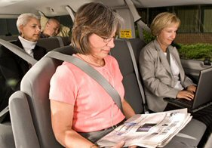
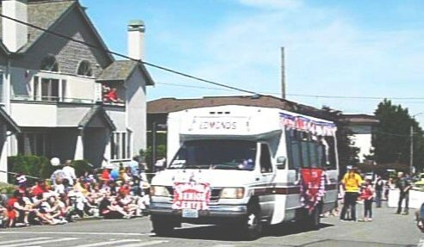
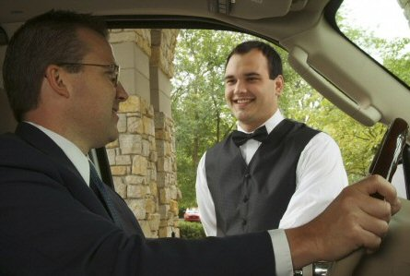
The Edmonds Senior Center Recommendations Summary
We Recommend
Multiple Solutions!
10

Slide 11
The Edmonds Senior Center Recommendations Summary
Thank you for the Opportunity to Help Our Community!
Edmonds Community College
Project Management 1
Fall 2016
11

Slide 12
The New Edmonds Waterfront Center Edmonds Senior Center
“Come for the view, stay for the friendships!”

